Slide 1
GEOSCIENCE WORKSHOP
CAPE TOWN
(South Africa)
27th to 28th August 2016

Slide 2

GIFT workshops provide first-hand access scientific information and materials to science teachers of primary and secondary schools.

Slide 3
This year the teacher enhancement workshop was held at the Iziko South African Museum from the 27th August to 28th August 2016 in Cape Town during the 35th International Geological Congress (IGC).
Out of nine Namibian teachers who were interviewed, five of us were selected to represent the country at the said congress and the following are the teachers who went for the workshop.

Slide 4
1. Ingenesia Katjinaani
(Fidel Castro Primary School)
2. Lena Mpingana shinavene (Van Ryn P.S)
3. Flanan Sikopo
(Jan Jonker Afrikaner High School)
4. Leon Husselmann
(Rehoboth High School)
5. Benjamin Ambambi
(Delta Primary School)

Slide 5
The trip to this wonderful workshop/Congress was made possible by First National Bank gave an amount of N$ 65 000.00. On behalf of my teaching colleagues, i want to thank the bank for its generous support.

Slide 6
The following countries were represented at this very workshop:
Namibia, South Africa, Lesotho, Swaziland, Algeria, Zimbabwe, Germany, England, USA.

Slide 7
The workshop started on Saturday 27/08/2016 at around 8:00 in the morning, the workshop was opened by the chairman Carlo Laj who gave the history of the GIFT.

Slide 8
This was followed by different presenters who talked about the natural resources of our countries and various ways on how we can conserve them. Effects of global prices on the minerals including ways on how we can look for alternatives to the current usage of energies used on the rest of our planet

Slide 9
Various speakers presented topics / Lessons on:
Volcanoes’
Environment and pollution
Tsunamis
Earth Quakes
Space science and asteroids

Slide 10
6. Minerals of our planet earth such as *Diamonds *Gold *Zinc * Tin
*Copper *Coal *Platinum
including some transition elements from the periodic table.

Slide 11
Three workshops were conducted and participants were grouped accordingly:
Dismantling of cellphones
Building blocks of matter, using jelly tots
Identification of minerals

Slide 12
Ellbrunner from Germany presented this:
Exercise: we were provided with cellphones, and the instruction was to disassemble and assemble them within a short period (20 minutes maximum).

Slide 13
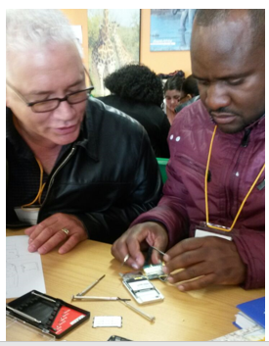

Slide 14
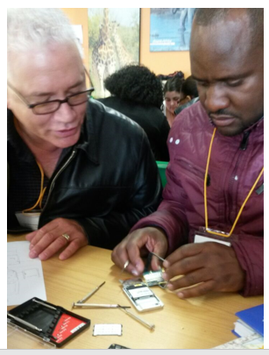

Slide 15
This exercise was meant to activate our minds
Innovation is the most convenient way to discover new knowledge
work in such a way that you make sure to discover complexity and at the same time discover solutions to the complexity problems.

Slide 16
How will this idea be implemented in my teaching class?
The answer is very simple, Innovation and technology is the key in advancing our country technologically.
Our minds cannot be limited to think in one direction
Namibian learners must learn to discover more ways of using technological gadgets to benefit the country at large.

Slide 17
The overall workshop rating is excellent looking at the objectives met at the end of various presenters:
We need these types of workshops because it equips teachers with recent knowledge of science.
It improves our teaching styles by using inquiry based learning which stimulates better learning in our learners.

Slide 18
It provides motivation to teachers because more confidence is build when exchanging ideas with other teachers across the globe.
Our country can benefit in the long run through these workshops.

Slide 19
PRECTICALS CONDUCTED
IN
CAPE TOWN

Slide 20
Tsunamis

Slide 21
Earth Quakes

